Slide 1
Diagrams and Figures
Big Data Summer Immersion at Yale
Shelby Golden, M.S.
June 27th, 2025

Slide 2
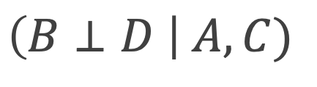
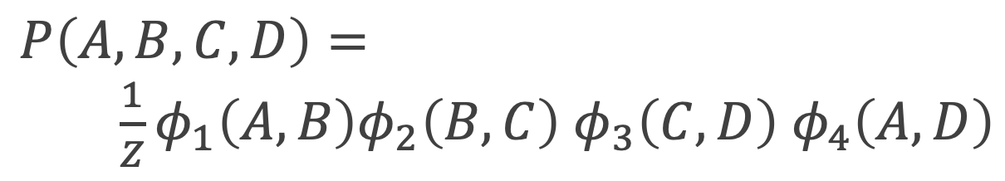
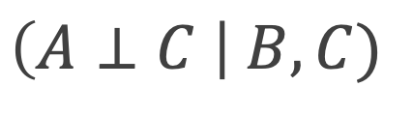

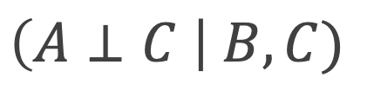

A
A
D
B
D
B
C
C
$$\left(A⊥C \right| B, C)$$
$$\left(A⊥C \right| B, C)$$
$$\left(B⊥D \right| A, C)$$
$$\left(B⊥D \right| A, C)$$
$$P\left(A,B, C, D\right)=$$
$\frac{1}{Z}φ_{1}\left(A,B\right)φ_{2}\left(B,C\right)$ $φ_{3}\left(C,D\right)$ $φ_{4}\left(A,D\right)$
$$P\left(A,B, C, D\right)=$$
$\frac{1}{Z}φ_{1}\left(A,B\right)φ_{2}\left(B,C\right)$ $φ_{3}\left(C,D\right)$ $φ_{4}\left(A,D\right)$

